Slide 1

Guess the exact number of jolly ranchers in the jar
----------------->

Slide 2
MGMT298D
Science and Strategy of AI
Week 2
Tree-Based Models:
CART, Random Forests, XGBoost
Auyon Siddiq UCLA Anderson School of Management

Slide 3



Slide 4
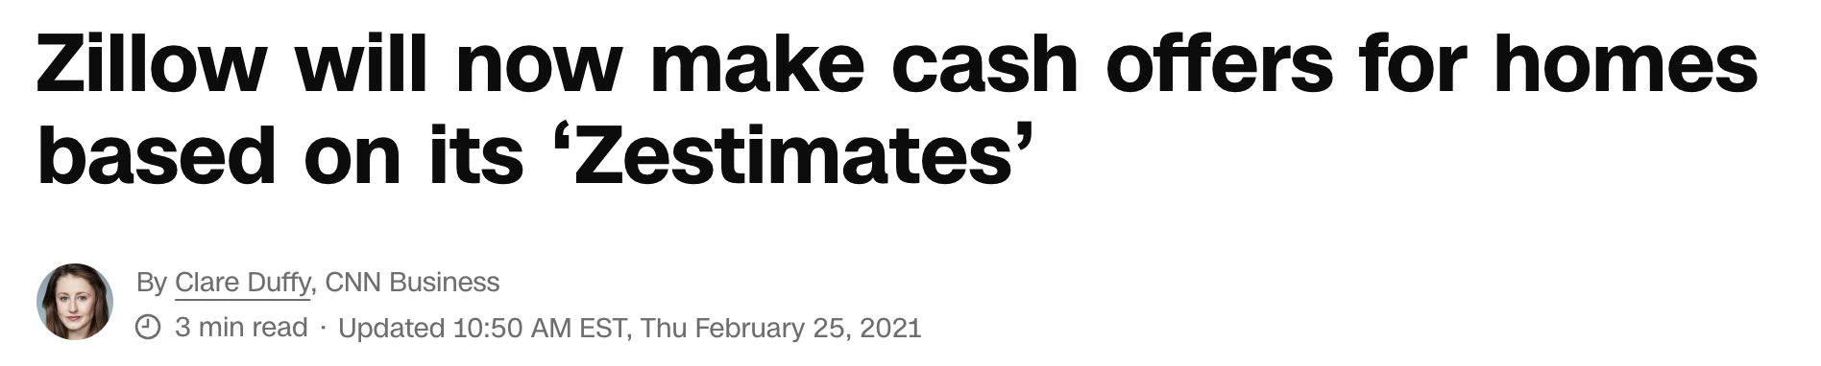
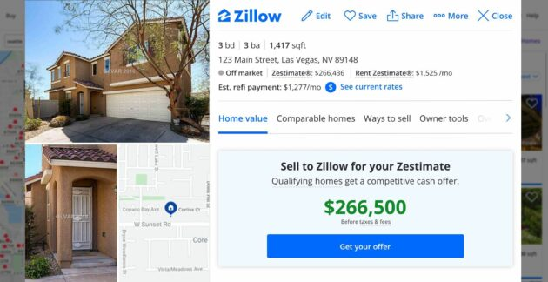

Slide 5
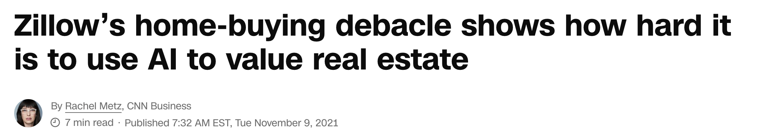
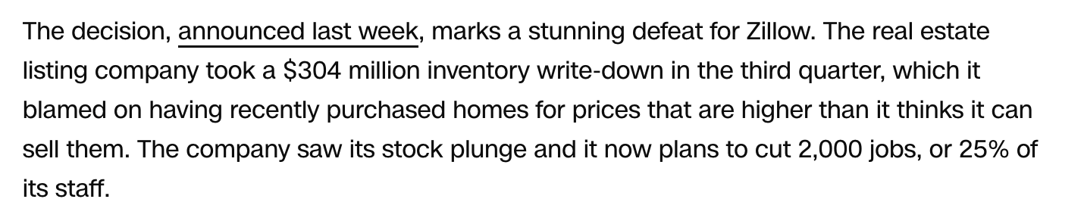

Slide 6
Algorithmic Pricing:
Carvana and Zillow
Case Handout

Slide 7
Week 1 Recap
Machine learning is a branch of AI focused on prediction from tabular data
ML and AI models are trained by minimizing a loss function – a measure of error between true labels and model predictions
Training optimization process gives us the model weights
Linear regression is an example of an ML model. Feature engineering allows for richer models (recall H&M sales) and regularization prevents overfitting to data
Regularization hyperparameters (LASSO, Ridge, ElasticNet) selected via cross-validation

Slide 8
Today’s Class
We’ll cover an alternative framework to linear regression for standard machine learning predictive tasks
Industry-strength “gold standard” method: XGBoost

Slide 9
Classification and
Regression Trees (CART)

Slide 10
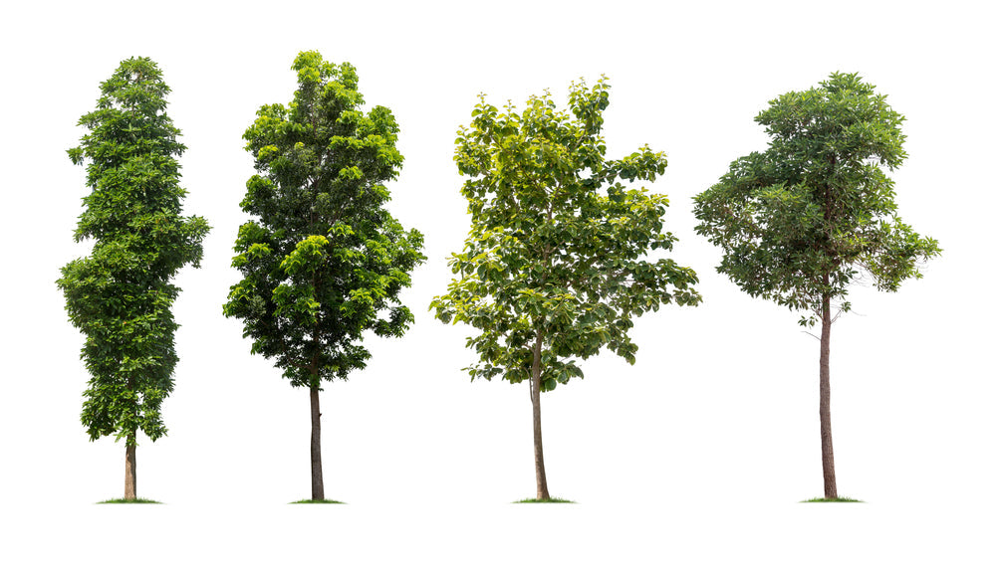
Classification and Regression Trees (CART)
Tree-based models: Alternative to linear regression for predictions
In addition to regression (predicting a number), can be used for classification (predicting a category) Together called “CART”, sometimes also “decision tree”

Slide 11

Regression Tree Example
Sample of 375 used Range Rovers

Slide 12
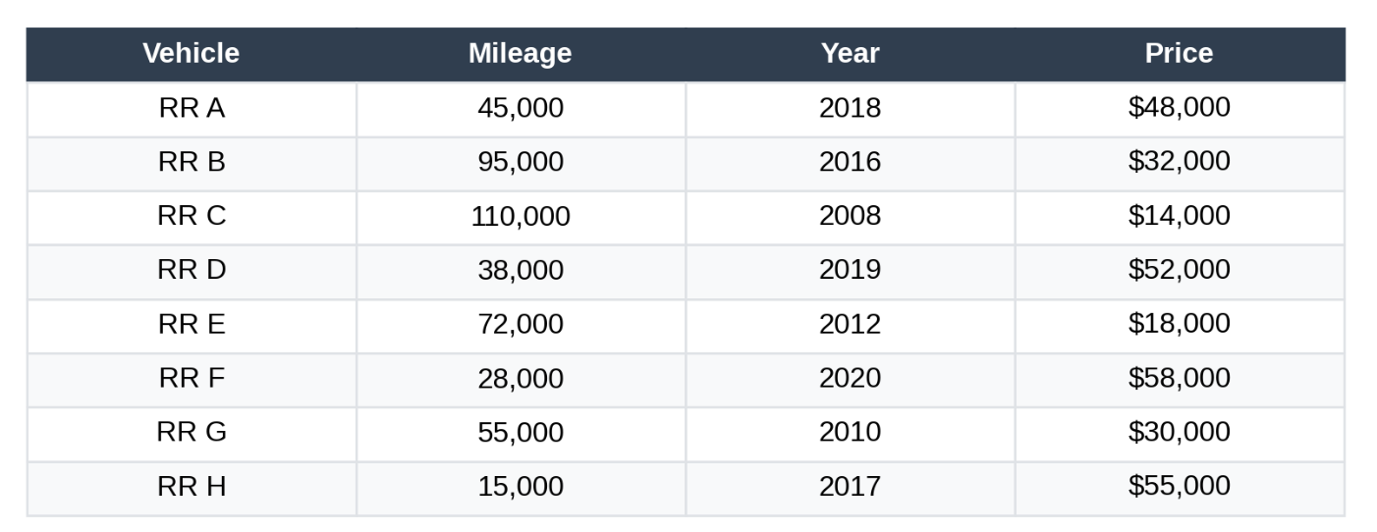
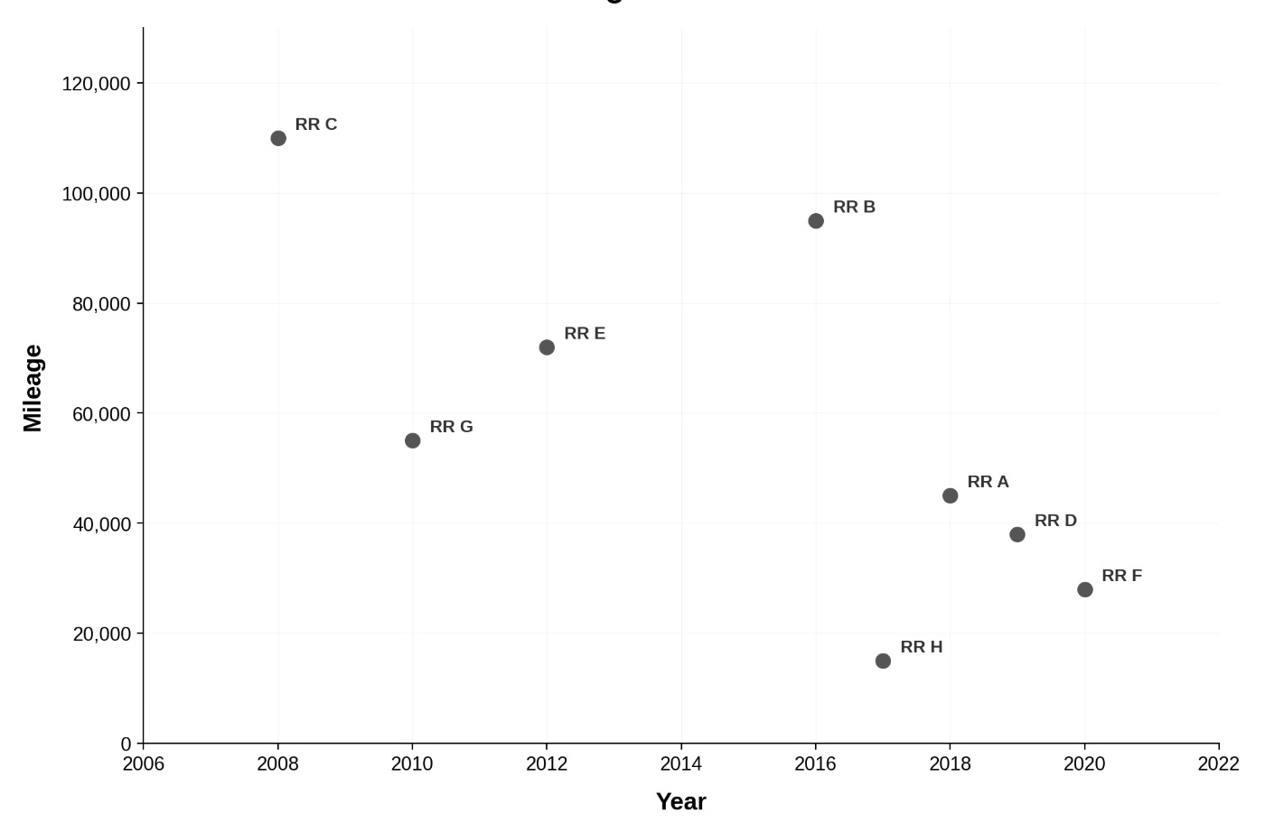

Slide 13
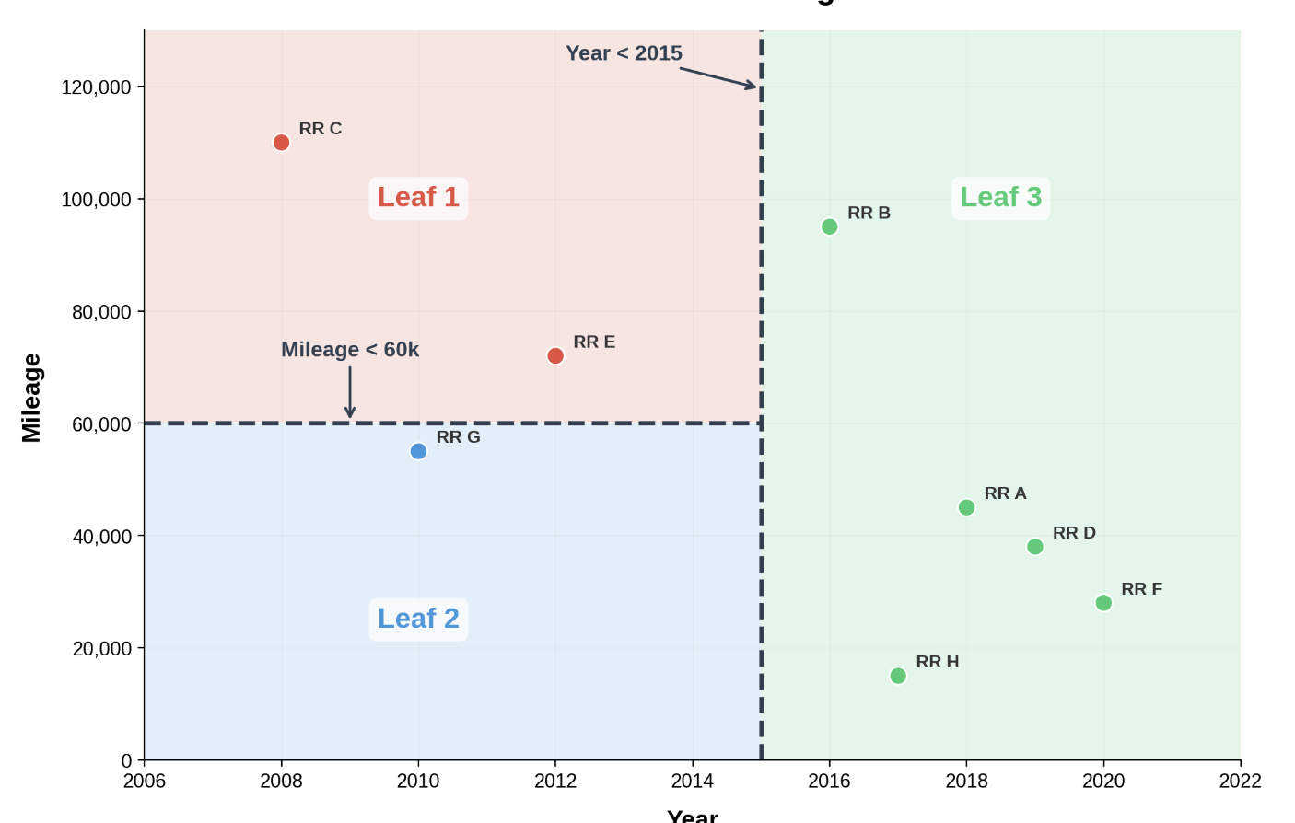
Each leaf = a prediction
average price of the vehicles in that leaf

Slide 14
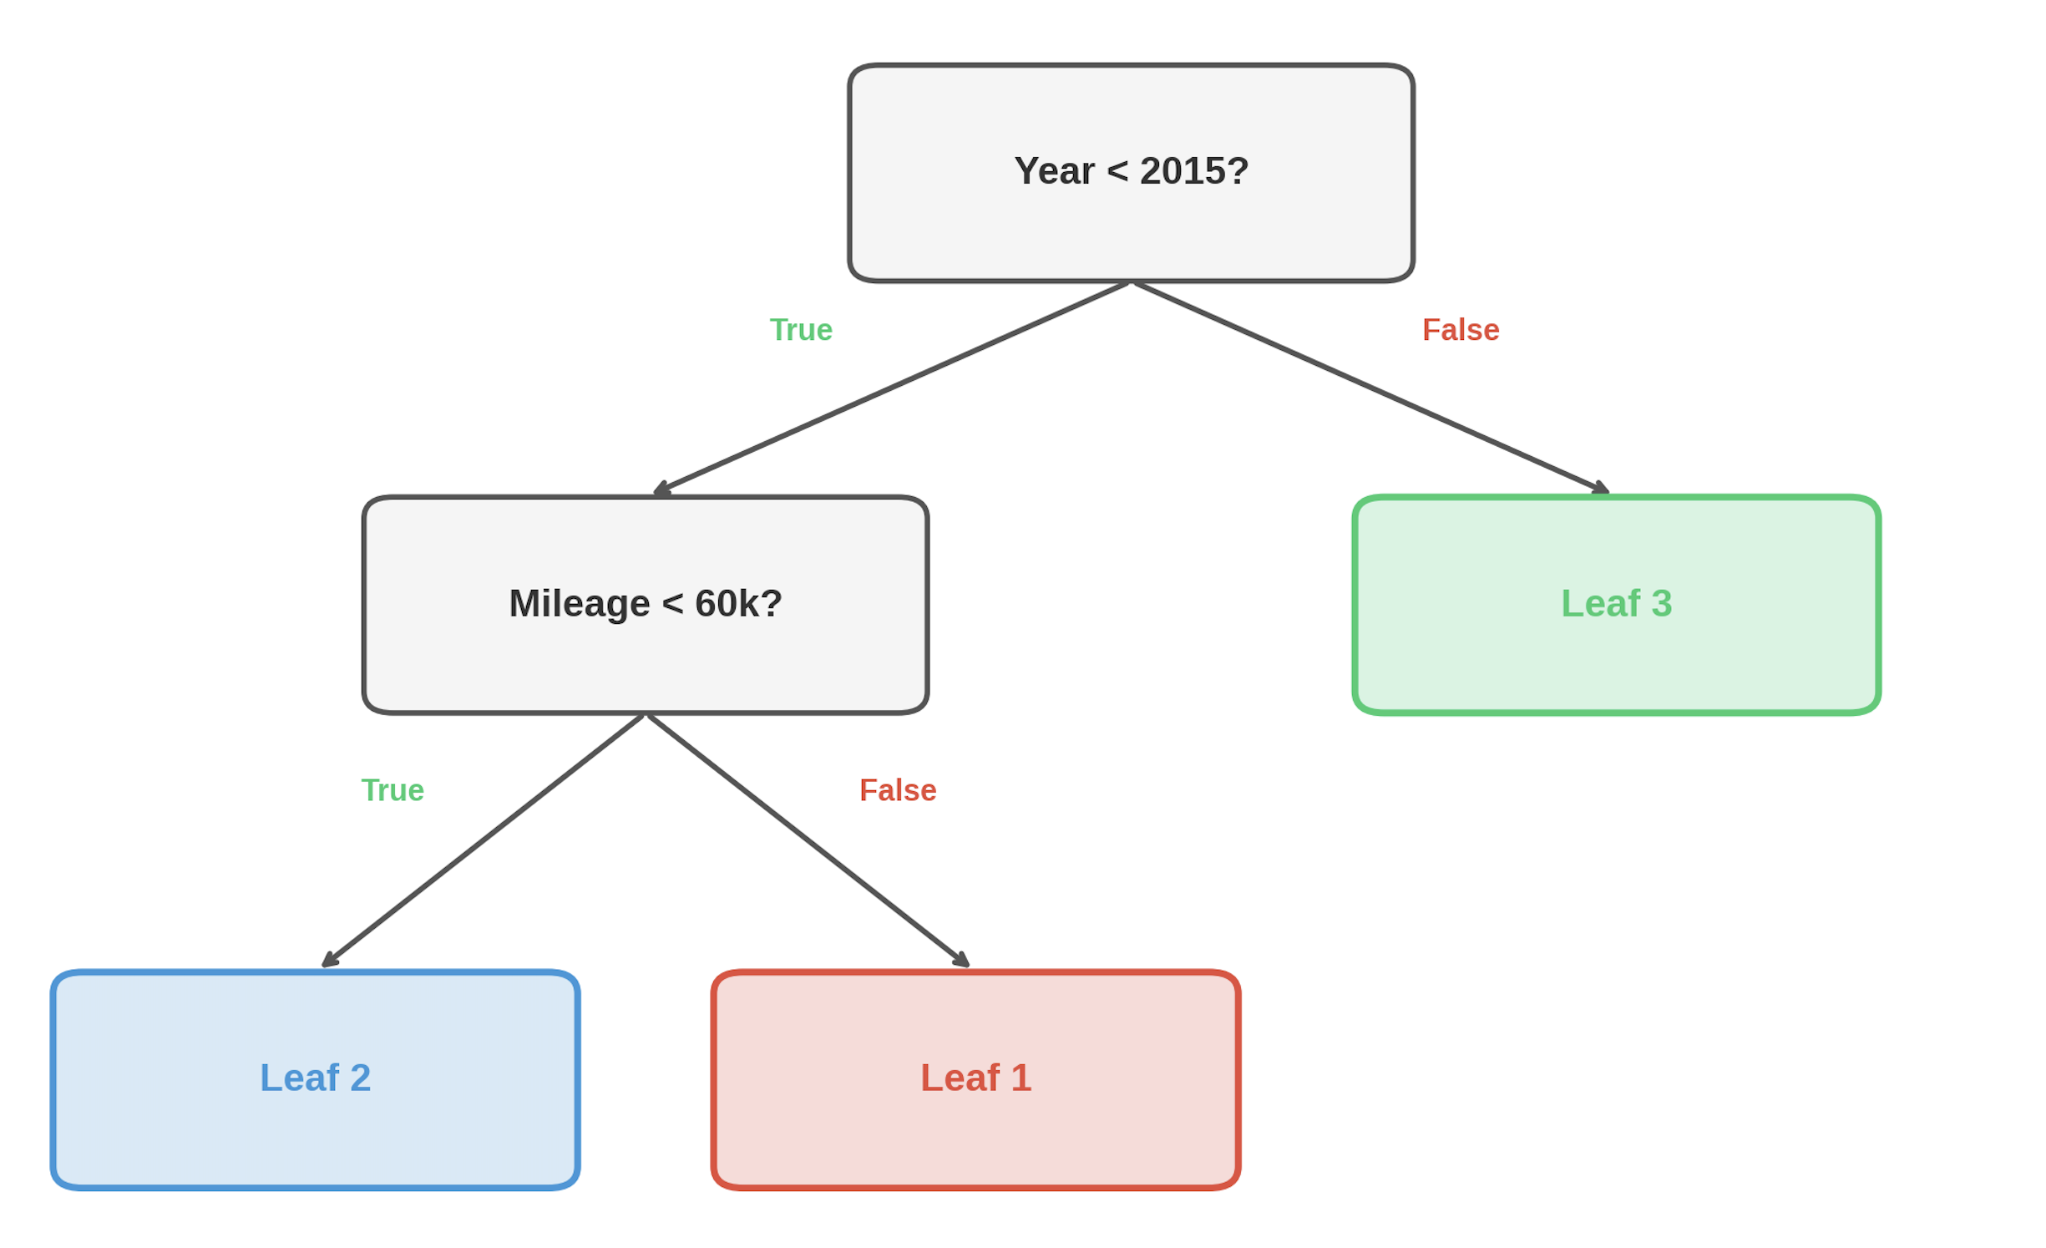
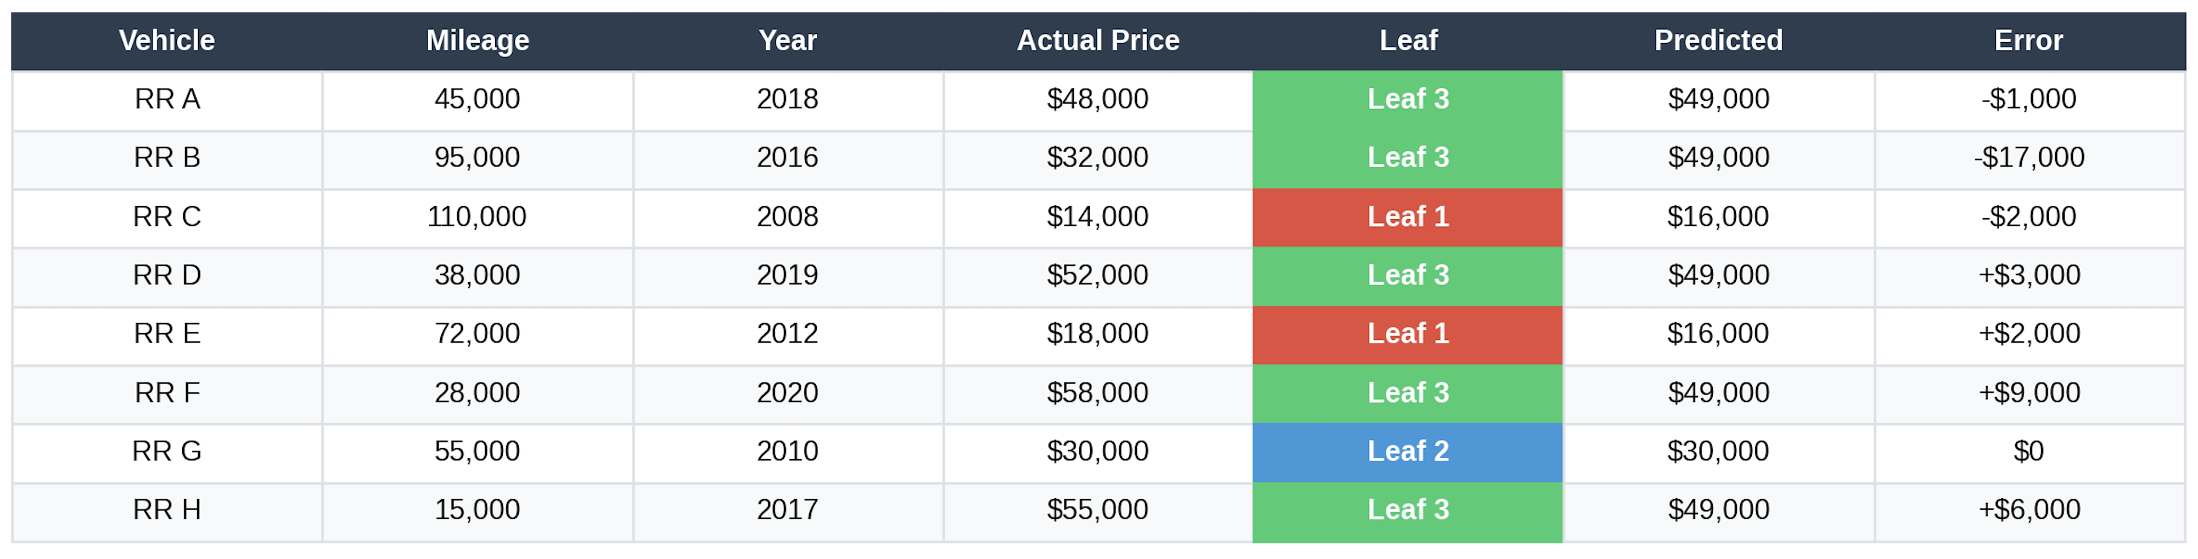

Slide 15
Training Regression Trees
Training linear regression = finding model weights
Training regression trees = finding split locations (“weight-free”)
Main idea: At each split point, choose a feature and threshold value that minimizes combined error from each new leaf

Slide 16
Regression Tree Splits

Slide 17
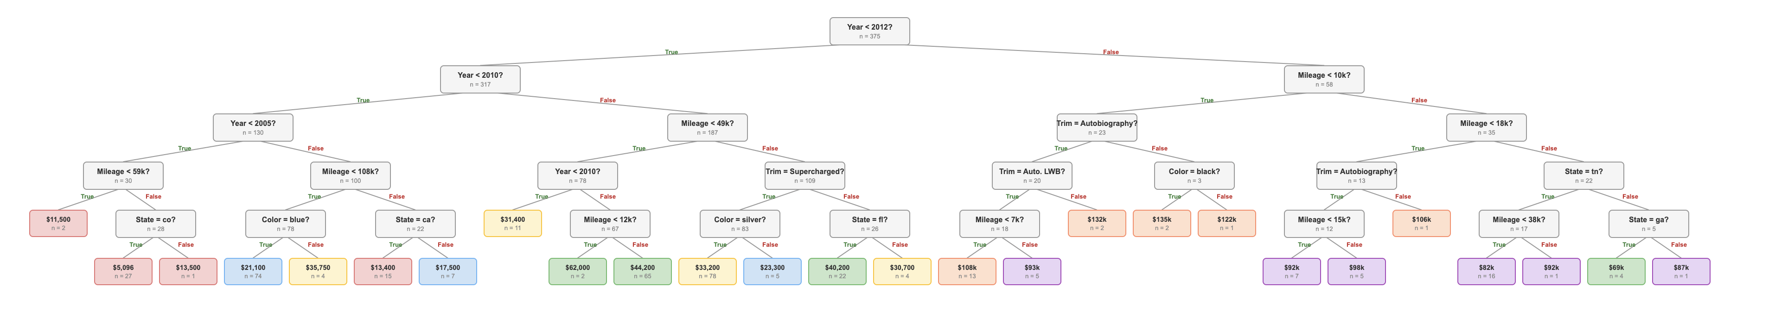
Depth & Overfitting in Trees
Model complexity determined by tree depth
Deep trees have stronger explanatory power, but also risk overfitting
Depth of 4-5 is standard in many applications

Slide 18
Feature Importance
Tree-based models tell you which features drive predictions the most, e.g.,
Mileage
35%
Year
28%
Trim Level
18%
State
10%
Color
5%
Other
4%

Slide 19
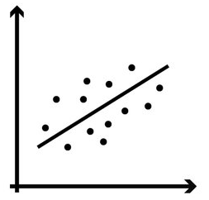
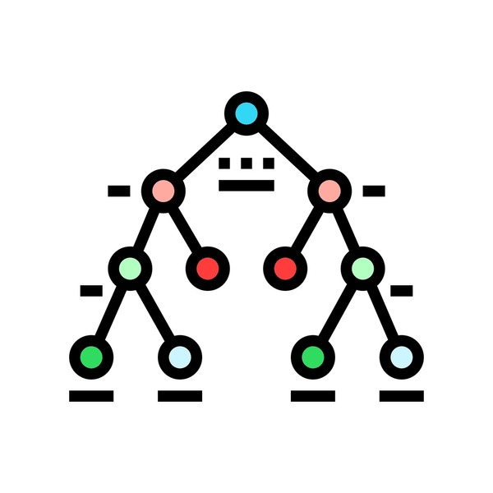
Trees vs Linear Regression
Linear regression:
Based on model weights, assumes linear relationship
Requires feature engineering to capture non-linear relationships
Generally does not overfit unless very small dataset and/or many features
Regression trees:
No model weights, based on splitting the feature data “directly”
Super flexible, no feature engineering required to capture non-linearity or variable interactions
Tree depth is key for model’s power – deeper trees catch richer patterns in data but more prone to overfitting
Can we do better?

Slide 20
Jolly Ranchers Results

Slide 21
Ensembles in Machine Learning
One of the most powerful ideas in ML: ensembles of models
Key idea: Train multiple models to produce predictions that outperform individual models
Intuition: Individual errors in models tend to cancel out, stabilizes predictions
“Wisdom of the crowds”

Slide 22
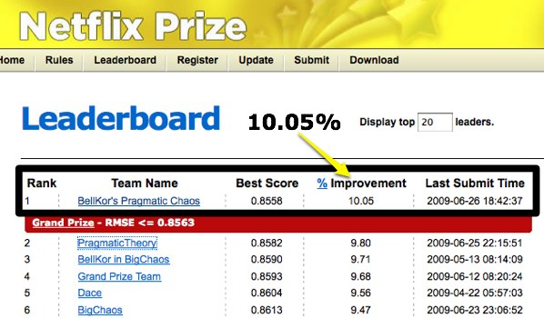

The Netflix Prize
Competition run by Netflix in late 2000s to beat in-house algorithm for recommendations by at least 10% After ~3 years, winning team was an ensemble of multiple top models

Slide 23
Random Forests

Slide 24
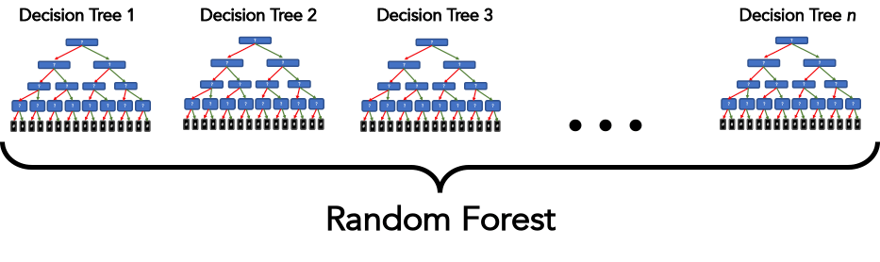
Random Forest: Parallel Tree Building

Slide 25
Training and Prediction
Training:
At each split, consider only a random subset of features (default is 1/3)
Train a single (deep) regression tree on this sample
Repeat steps 1-3 for as many trees as you like (20, 100, 500)
Prediction:
Each tree makes one prediction, final prediction is simply the average:
Prediction = (Tree₁ + Tree₂ + ... + Tree₅₀₀) / 500

Slide 26
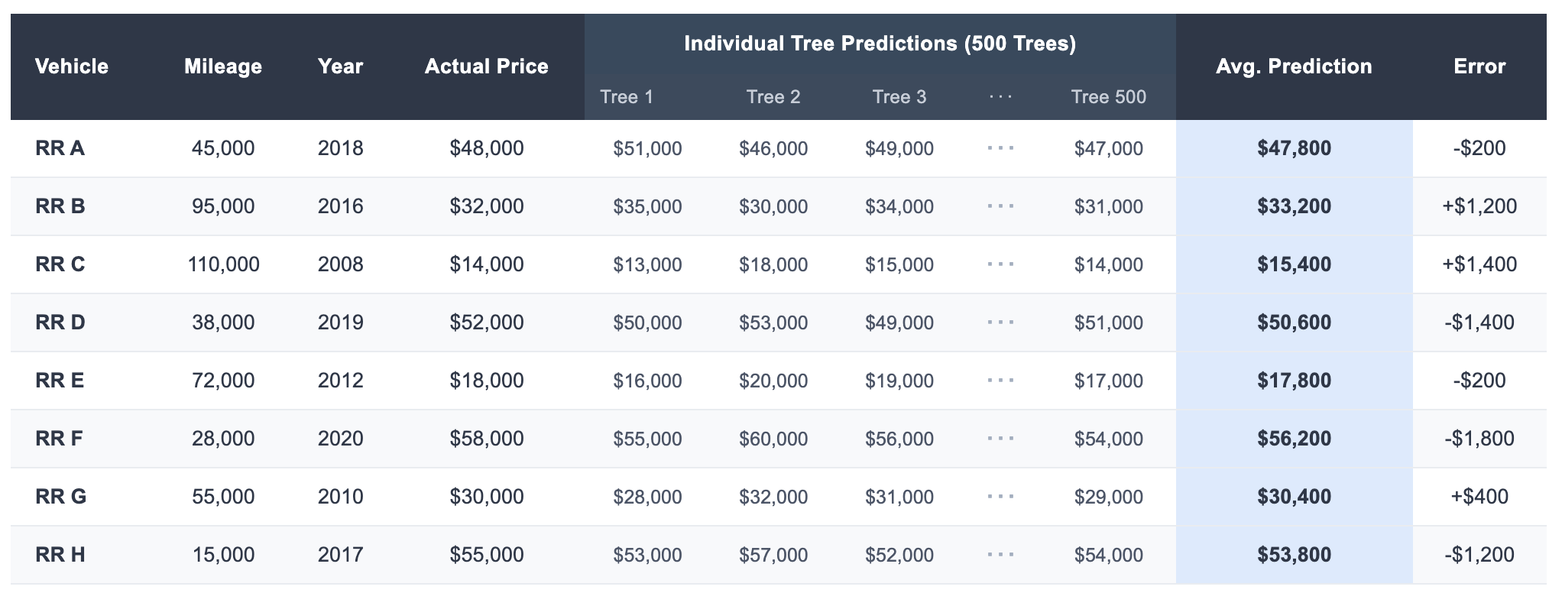
Random Forest: Numerical Example
Each tree gives a slightly different prediction; the average is more stable:
MAE: $875
Averaging reduces noise — more stable than any single tree

Slide 27
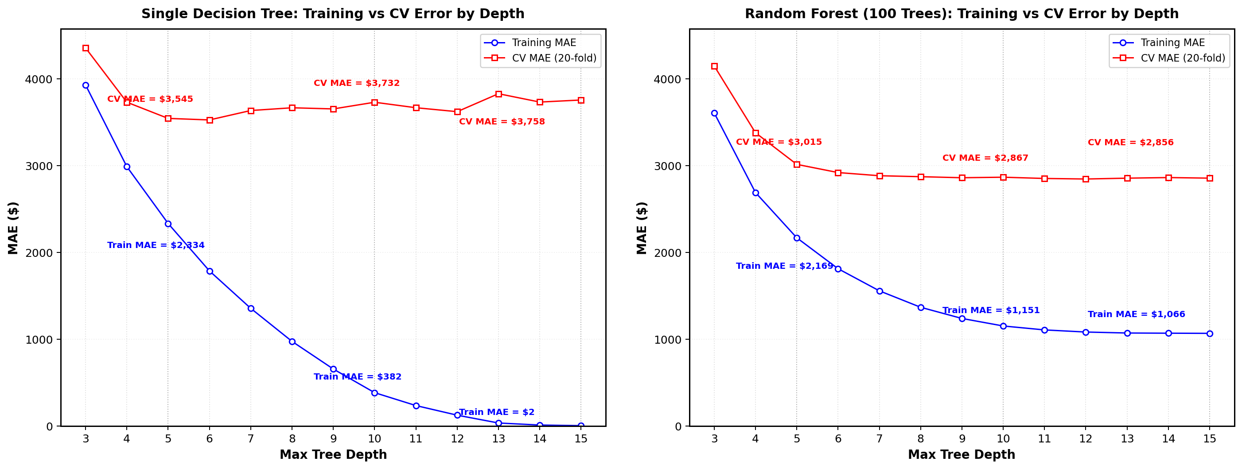
Random Forest: Numerical Example
Single tree
Random forest with 100 trees

Slide 28
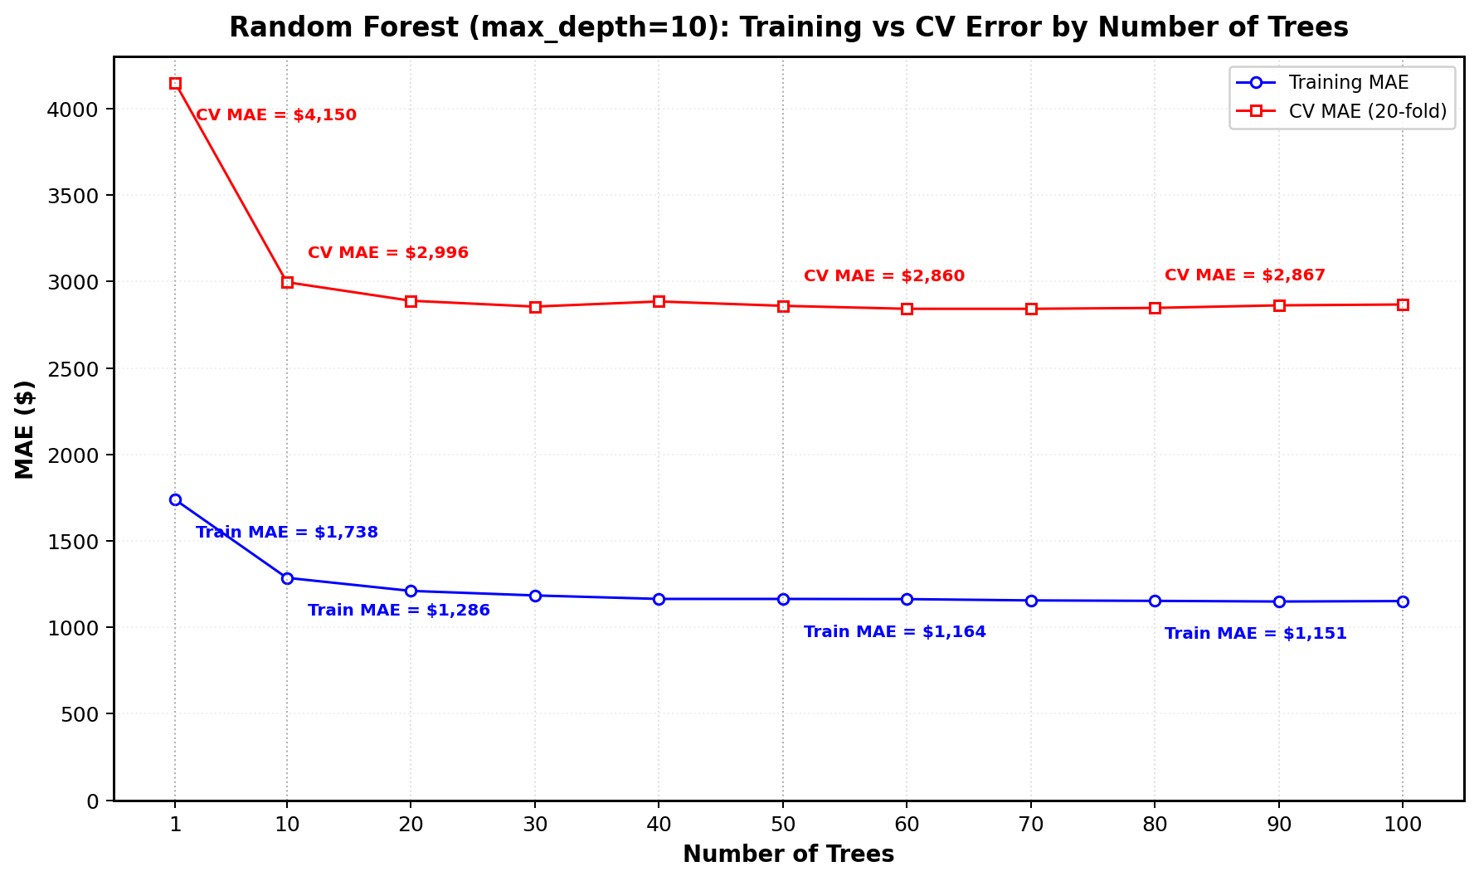
Random Forest: Numerical Example
Random forest with depth = 10

Slide 29
Random Forest Hyperparameters
Number of trees: Typical: 50–500. Usually diminishing returns. Easier prediction problems need fewer trees
Maximum tree depth: Typical: 10–15. Deeper OK since averaging predictions controls overfitting
Maximum features: Features to consider per split. Typical: n/3.

Slide 30
Summary: Trees vs. Forests vs. XGBoost
Single Tree
Random Forest
Interpretability
Interpretability
High
Low
Predictive Accuracy
Accuracy
Moderate
High
Overfitting Risk
Overfitting Risk
High
Low
Tuning Required
Tuning Required
Moderate
Low

Slide 31

15-min Break

Slide 32
Tree Models in Practice

Slide 33
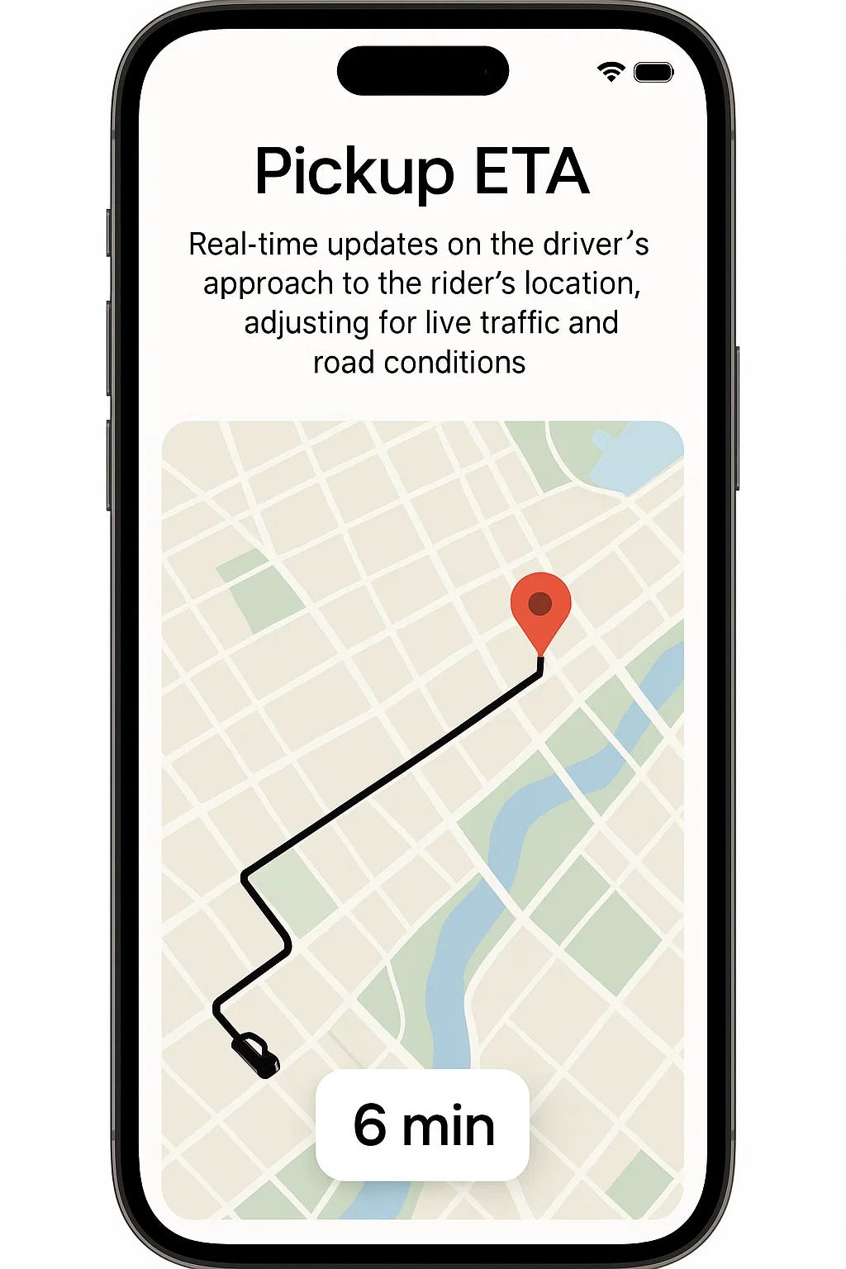
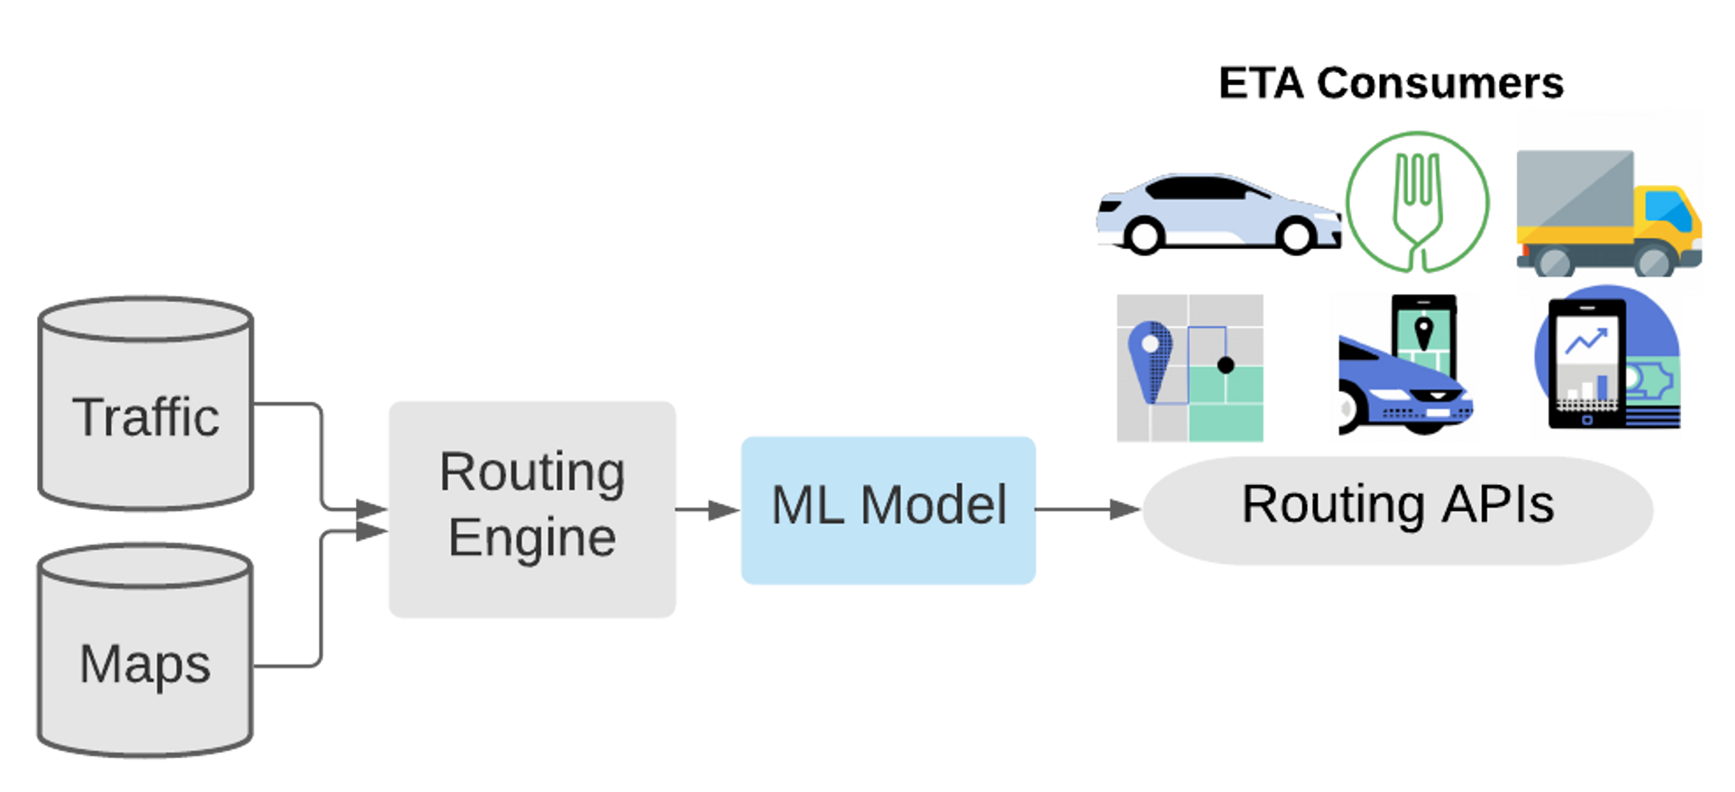
Uber: ETA Predictions
Prediction task: Predict estimated time of arrival (ETA) for Uber trips Features: traffic conditions, route + map details Label: travel time
https://www.uber.com/us/en/blog/deepeta-how-uber-predicts-arrival-times/

Slide 34


Airbnb: Search Ranking for Experiences
Prediction task: Predict which experiences users will click or book Features: experience duration, price, category, reviews, occupancy, number of bookings, user click history Label: if user clicks, if user books
https://medium.com/airbnb-engineering/machine-learning-powered-search-ranking-of-airbnb-experiences-110b4b1a0789

Slide 35
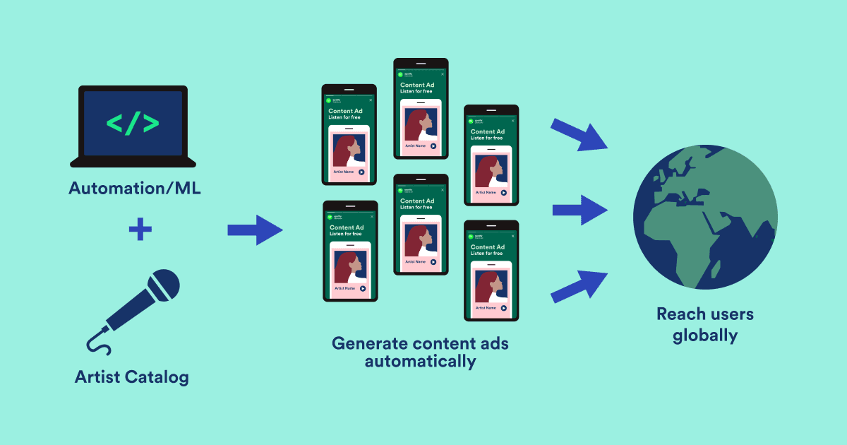
Spotify: Content Marketing
Prediction task: Predict success rate of online ad campaigns Features: artist shown, ad creative design details, market Label: conversion rate (e.g., new user sign-ups)
https://engineering.atspotify.com/2023/11/how-we-automated-content-marketing-to-acquire-users-at-scaleAr

Slide 36

XGBoost

Slide 37
Parallel vs Sequential Trees
Two common approaches to ensemble methods: parallel vs sequential models
Parallel: train independent ML models and average / combine predictions
→ Random Forest
Sequential: Train models one at a time, with each model building on the last
→ XGBoost

Slide 38
XGBoost: The Algorithm
Instead of predicting the target directly, each new tree predicts the error from all previous trees
Prediction = Base + η·Tree₁ + η·Tree₂ + η·Tree₃ + ...
The learning rate η determines how much each new tree’s prediction contributes to overall prediction
Lower η → more trees needed, but more accurate / less overfitting risk
Overall training error shrinks with each tree

Slide 39


XGBoost: Numerical Example
XGBoost: Each tree fits the residual left by all previous trees
Each tree uses a random subsample of data
 |  |  |  | Sequential Trees (η = 0.1)
Vehicle | Actual Price | Base | Resid₀ | Tree 1 | η × T1 | Resid₁ | Tree 2 | η × T2 | Resid₂ | Tree 3 | η × T3 | Resid₃ | Final Pred.
RR A | $48,000 | $36,500 | $11,500 | $7,500 | $750 | $10,750 | $7,000 | $700 | $10,050 | $6,500 | $650 | $9,400 | $38,600
RR B | $32,000 | $36,500 | -$4,500 | -$2,500 | -$250 | -$4,250 | -$2,500 | -$250 | -$4,000 | -$2,000 | -$200 | -$3,800 | $35,800
RR C | $14,000 | $36,500 | -$22,500 | -$15,500 | -$1,550 | -$20,950 | -$14,500 | -$1,450 | -$19,500 | -$13,500 | -$1,350 | -$18,150 | $32,150
RR D | $52,000 | $36,500 | $15,500 | $9,500 | $950 | $14,550 | $8,500 | $850 | $13,700 | $8,000 | $800 | $12,900 | $39,100

Slide 40
XGBoost: Numerical Example
XGBoost: Each tree fits the residual left by all previous trees
Each tree uses a random subsample of data
 |  |  |  | Sequential Trees (η = 0.1)
Vehicle | Actual Price | Base | Resid₀ | Tree 1 | η × T1 | Resid₁ | Tree 2 | η × T2 | Resid₂ | Tree 3 | η × T3 | Resid₃ | Final Pred.
RR A | $48,000 | $36,500 | $11,500 | $7,500 | $750 | $10,750 | $7,000 | $700 | $10,050 | $6,500 | $650 | $9,400 | $38,600
RR B | $32,000 | $36,500 | -$4,500 | -$2,500 | -$250 | -$4,250 | -$2,500 | -$250 | -$4,000 | -$2,000 | -$200 | -$3,800 | $35,800
RR C | $14,000 | $36,500 | -$22,500 | -$15,500 | -$1,550 | -$20,950 | -$14,500 | -$1,450 | -$19,500 | -$13,500 | -$1,350 | -$18,150 | $32,150
RR D | $52,000 | $36,500 | $15,500 | $9,500 | $950 | $14,550 | $8,500 | $850 | $13,700 | $8,000 | $800 | $12,900 | $39,100

Slide 41
XGBoost Hyperparameters
XGBoost is very sensitive to tuning parameters and more prone to overfitting than random forests
Three main parameters:
1. learning rate (0.01 to 0.3)
2. number of trees (50 to 1000)
3. max tree depth (3-6)
Typical range
An optional parameter is data subsample: Each tree fits to a random sample (e.g. 70%) of the training data. Helps a bit with regularization

Slide 42
Summary: Trees vs. Forests vs. XGBoost
Single Tree
Random Forest
XGBoost
Interpretability
Interpretability
Interpretability
High
Low
Low
Accuracy
Accuracy
Accuracy
Moderate
High
Very High
Overfitting Risk
Overfitting Risk
Overfitting Risk
High
Low
Moderate
Tuning Required
Tuning Required
Tuning Required
Moderate
Low
High

Slide 43
Best Practices:
Hyperparameter Tuning

Slide 44
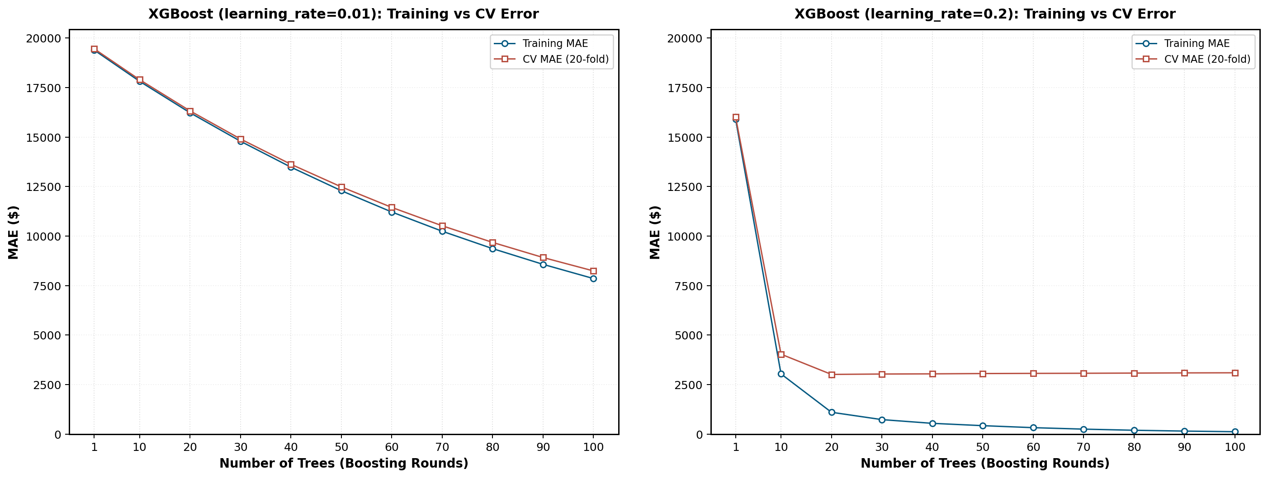
learning_rate (η)
η = 0.01
η = 0.2

Slide 45
Best Practices: Hyperparameter Tuning
1. Start with defaults. If it works good enough “out of the box”, use as is
2. Tune hyperparameters. Try a handful of different combinations; number of trees and learning rate matter more than tree depth
3. Use proper validation. Use cross-validation to choose hyperparameters, keep test set for “final” evaluation
4. Monitor for overfitting. Keep an eye on train vs. validation error. Excessive divergence = overfitting

Slide 46
Which model should you use?
Single Tree
Random Forest
XGBoost
Interpretability
Interpretability
Interpretability
High
Low
Low
Accuracy
Accuracy
Accuracy
Moderate
High
Very High
Overfitting Risk
Overfitting Risk
Overfitting Risk
High
Low
Moderate
Tuning Required
Tuning Required
Tuning Required
Moderate
Low
High

Slide 47


Slide 48
Assignment 2

Slide 49
Glossary (1/2)
Decision Tree (CART)
A model that makes predictions by splitting data with yes/no questions, forming a tree of decision rules.
Leaf Node
The smallest unit of a decision tree that contains a prediction value, such as the average price of all data points that landed there.
Tree Depth
The number of levels of splits in a tree; deeper trees are more complex and more prone to overfitting.
Hyperparameter
A setting chosen before training that controls model behavior, such as tree depth or learning rate. Not learned from data.
Feature Importance
A score showing how much each input variable contributed to the model's predictions.
Random Forest
An ensemble of many decision trees, each trained on a random sample of data, whose predictions are averaged for stability.

Slide 50
Glossary (2/2)
Ensemble
A method that combines multiple models to produce predictions that outperform any individual model, leveraging the “wisdom of the crowds.”
XGBoost
A sequential ensemble algorithm that builds trees one at a time, where each new tree focuses on correcting the errors of previous trees.
Residuals
The difference between actual values and current predictions; in XGBoost, each new tree is trained to predict these gaps.
Learning Rate (eta)
A shrinkage factor that controls how much each new tree contributes to the overall prediction; lower values reduce overfitting but require more trees.

